Slide 1
2013 COSO Internal Control Integrated Framework

Slide 2
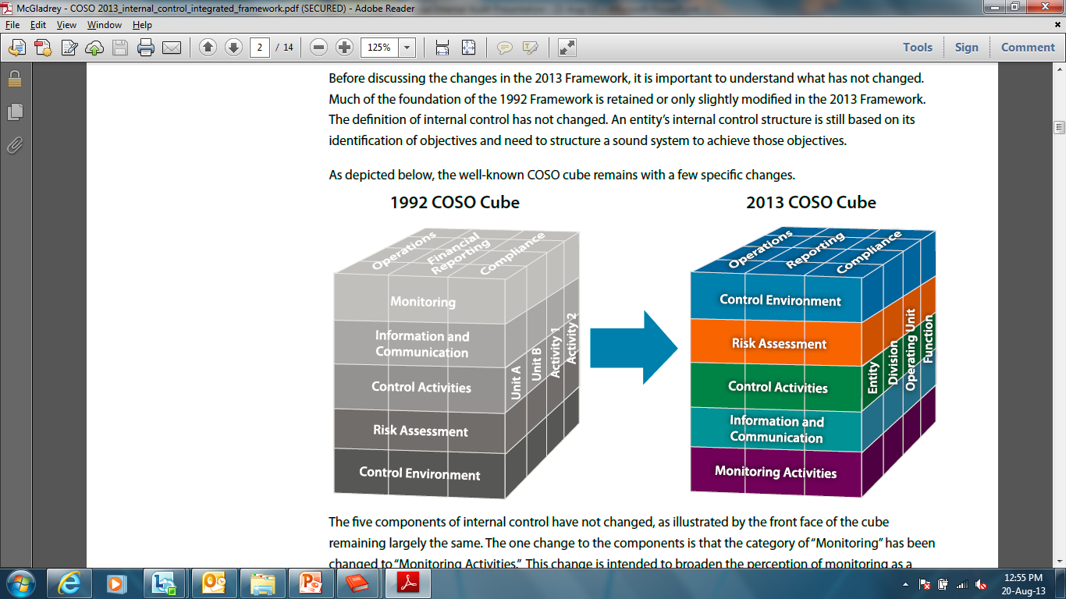
Introduction
In 1992, the Committee Of Sponsoring Organizations of the Treadway Commission (COSO) published Internal Control-Integrated Framework (1992 framework) which has become commonly known as the COSO framework.
In May 2013, COSO issued an updated Internal Control-Integrated framework (2013 framework) to reflect changes in the business world for over 20 years since the original framework.

Slide 3
Why update?
Regulatory scrutiny | Accounts for a growing web of global regulations, like financial reporting requirements and environmental standards.
Increased reliance on technology | Provides a principle directed at controls over technology—infrastructure, development, use, and links with other processes.
Expectation for additional reporting | Extends to cover non-financial reporting objectives, like sustainability reports and customer satisfaction measures.
Complex, interconnected business | Helps you customize controls and see if they’re supporting multiple objectives and principles.
Accelerating pace of businesses | Provides principles that help you adapt controls for planned changes and unforeseen circumstances—and keep them in sync with the business
Greater complexity in management models and legal structures | Explicitly considers business models and helps you apply controls across management operating models and legal entity structures

Slide 4
What is not changing?
Core definition of internal control.
“A process, effected by an entity’s board of directors, management and other personnel. This process is designed to provide reasonable assurance regarding the achievement of objectives in effectiveness and efficiency of operations, reliability of financial reporting, and compliance with applicable laws and regulations.”
Three categories of objectives and five components of internal control.
Each of the five components of internal control are required for effective internal control.
Important role of judgment in designing, implementing and conducting internal control, and in assessing its effectiveness.

Slide 5
What is changing?
The component of “Monitoring” has been changed to “Monitoring Activities”.
The component of “Financial Reporting” has been changed to “Reporting”.
Notes:
1. The change to “Monitoring Activities” is intended to broaden the perception of monitoring as a series of activities undertaken individually and as a part of each of the other four components, rather than as one unique process.
2. The change to “Reporting” to broaden the application of the framework not only to external financial reporting but also to include internal reporting as well as external reporting of non-financial measures.

Slide 6
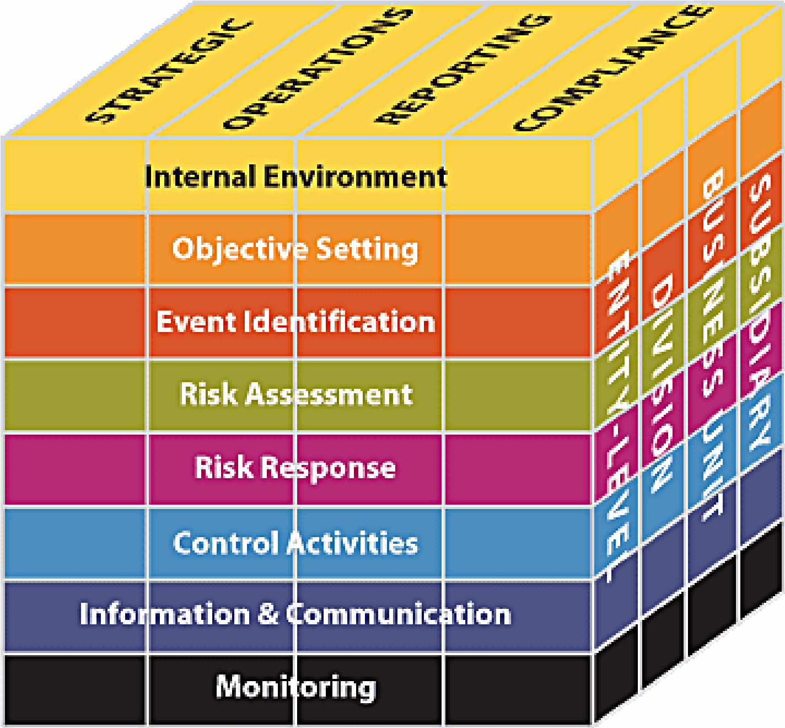
What is changing?
3. Along the right side of the cube, the organization structure has been changed to align with COSO’s ERM Framework and also better illustrate that an effective internal control structure permeates an entire organization at all functional levels both independently and interdependently.
2013 COSO Framework
COSO’S ERM Framework

Slide 7
What is changing?
4. It adds 17 new principles with 81 points of focus to the five components that are necessary for effective internal control.
5. It contains more guidance on how technology relates to an entity’s internal control structure. The 2013 framework includes more focus on technology throughout the components of internal control as well as broader focus on the impacts of the technology on the internal control structure rather than on the specific types of technology.
6. It includes expanded guidance and considerations related to outside resources, such as third-party processors.
7. It expands the reporting aspects of internal control to consider more than just financial reporting, including external reporting of non-financial information and internal reporting.
8. It includes additional guidance for business with global reach.

Slide 8
1. Control Environment
1992 COSO | 2013 COSO
Communication and enforcement of integrity and ethical values | The organization demonstrates a commitment to integrity and ethical values.
Commitment to competence | The Board of Directors (BoD) demonstrates independence from management and exercises oversight of the development and performance of internal control.
Participation by those charged with governance (BoD, AC, management) | Management establishes, with board oversight, structures, reporting lines, and appropriate authorities and responsibilities in the pursuit of objectives.
Management's Philosophy and Operating Style | The organization demonstrates a commitment to attract, develop, and retain competent individuals in alignment with objectives.
Organizational Structure | The organization holds individuals accountable for their internal control responsibilities in the pursuit of objectives.
Assignment of authority and responsibility | -
Human resource policies and practices | -

Slide 9
2. Risk Assessment
1992 COSO | 2013 COSO
1. Company-wide Objectives | The organization specifies objectives with sufficient clarity to enable the identification and assessment of risks relating to objectives.
2. Process-level Objectives | The organization identifies risks to the achievement of its objectives across the entity and analyzes risks as a basis for determining how the risks should be managed.
3. Risk Identification and Analysis | The organization considers the potential for fraud in assessing risks to the achievement of objectives.
4. Managing Change | The organization identifies and assesses changes that could significantly impact the system of internal control.
Notes:
Fraud risk considerations:
1. Management bias, for instance in selecting accounting principles
2. Degree of estimates and judgments in external reporting
3. Fraud schemes and scenarios common to the industry sectors and markets in which the entity operates
4. Geographic regions where the entity does business
5. Incentives that may motivate fraudulent behavior
6. Nature of technology and management’s ability to manipulate information
7. Unusual or complex transactions subject to significant management influence
8. Vulnerability to management override and potential schemes to circumvent existing control activities”

Slide 10
3. Control Activities
1992 COSO | 2013 COSO
1. Policies and Procedures | The organization selects and develops control activities that contribute to the mitigation of risks to the achievement of objectives to acceptable levels.
2. Security (Application and Network) | The organization selects and develops general control activities over technology to support the achievement of objectives.
3. Application Change Management | The organization deploys control activities through policies that establish what is expected and procedures that put policies into action.
4. Business Continuity / Backups | -
5. Outsourcing | -

Slide 11
4. Information And Communication
1992 COSO | 2013 COSO
1. Quality of Information | The organization obtains or generates and uses relevant, quality information to support the functioning of internal control.
2. Effectiveness of Communication | The organization internally communicates information, including objectives and responsibilities for internal control, necessary to support the functioning of internal control.
- | The organization communicates with external parties regarding matters affecting the functioning of internal control.

Slide 12
5. Monitoring Activities
1992 COSO | 2013 COSO
1. On-going Monitoring | The organization selects, develops, and performs ongoing and/or separate evaluations to ascertain whether the components of internal control are present and functioning.
2. Separate Evaluations | The organization evaluates and communicates internal control deficiencies in a timely manner to those parties responsible for taking corrective action, including senior management and the BoD, as appropriate.
3. Reporting Deficiencies | -

Slide 13
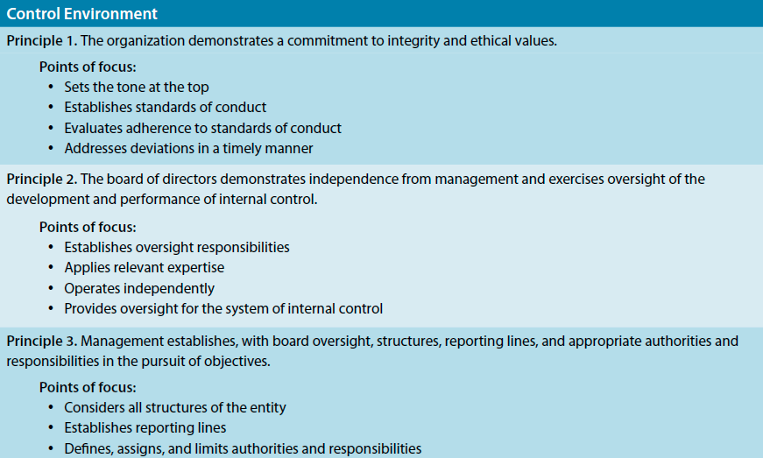
81 points of focus

Slide 14
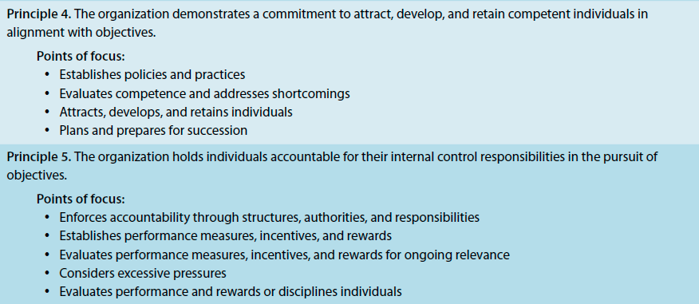
81 points of focus (Control Environment contd.)

Slide 15
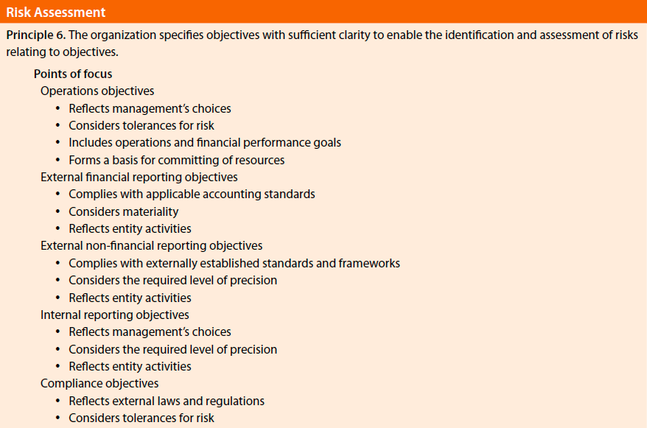
81 points of focus

Slide 16
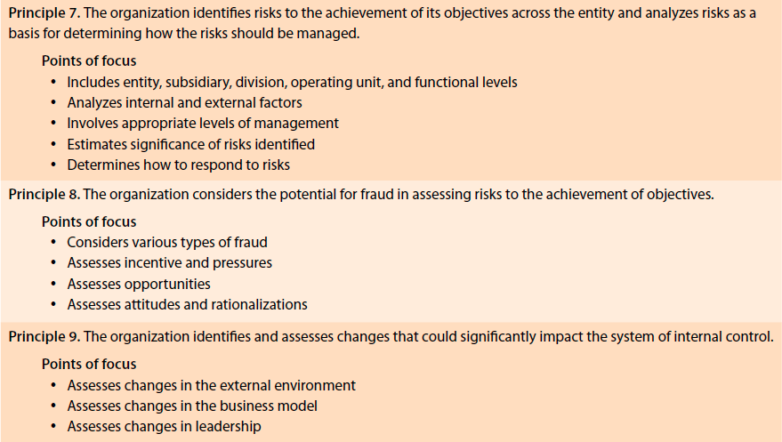
81 points of focus (Risk Assessment contd.)

Slide 17
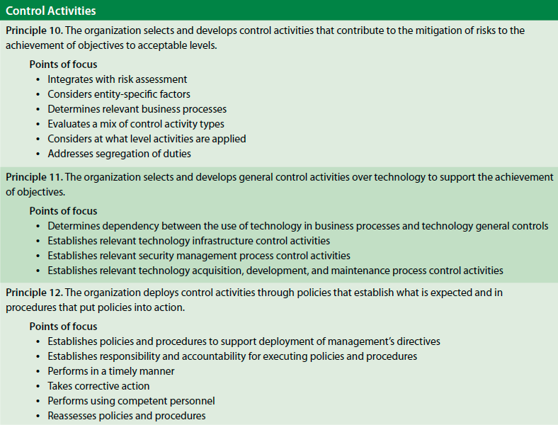
81 points of focus

Slide 18
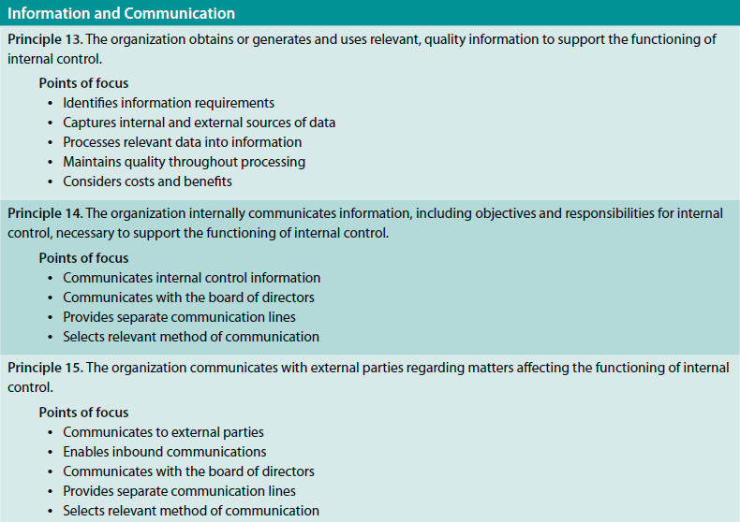
81 points of focus

Slide 19
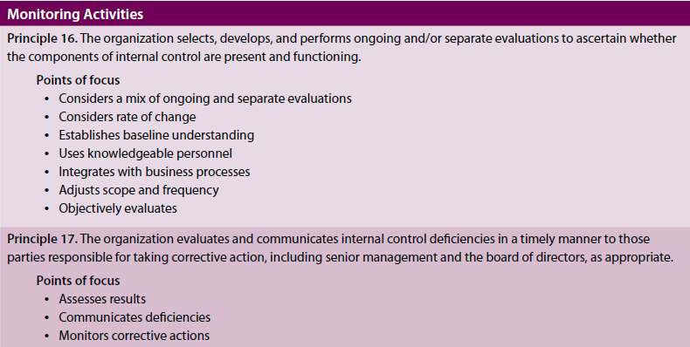
81 points of focus

Slide 20
Transition
Updated Framework will supersede original Framework at the end of the transition period (i.e., December 15, 2014).
Users are encouraged to transition applications and related documentation to the updated Framework as soon as feasible.
During the transition period, external reporting should disclose whether the original or updated version of the Framework was used.

Slide 21
How to start?
Management should:
Develop and implement a transition plan timely to meet key objectives – e.g., apply updated Framework by December 31, 2014 for external reporting.
Mapping the Company’s existing internal control structure to the 2013 framework and identify any potential gap.
Mapping the 2013 points of focus to the Company’s current internal control and identify any potential gap.
For identified gaps, management should develop and document a plan to remediate the difference.
Internal Auditor is encouraged to:
Offer consulting service by presenting this COSO update to the audit committee, C-suite, operating unit and functional management or
Offer consulting service by assessing four points mentioned above or
Offer assurance service to assess the adequacy of management’s assessment on the updated COSO framework.

Slide 22
Further Reading
COSO Illustrative Tools for Assessing Effectiveness of a System of Internal Control.
COSO Internal Control over External Financial Reporting: A Compendium of Approaches and Examples, which illustrates how various characteristics of principles may be present and functioning within a system of internal control to external financial reporting objectives.

Slide 23
Thank you!
Questions and comments..

